Slide 1
Working with Difference, Diversity & Inclusion using Anti-Oppressive Practice Foundations (DD&A)
(1) Base Concepts, Oppression, Marginalization & Mental Health
(2) Implications for working with Difference, Diversity, and Marginalisation
(3) Embedding DD&A into Therapeutic Practice & Ecologically
* Images Pixabay/Unsplash
Notes:
1 1.3 10-11.30 2 1.15 11.45-1pm 3 1.15 2-3.15 4 1 3.30-4.30

Slide 2
Deep Acknowledgement
We wish to acknowledge Liberation, Feminist, LGBTQ2+, Black, Disability, ND, and Indigenous Psychologies and Theorists
Regardless of our worldview we accept social inequalities exist and we are to a degree accepting of it whether aware or not?

Slide 3
Base Concepts, Oppression, Marginalisation & Mental Health
A Psychological Practitioners Path for Embedding DD&A within Self & Practice

Slide 4
Learning outcomes
Aim
To understand the anti-oppressive practice and its need for Difference, Diversity & Inclusion
Objectives
Base concepts
Understand how oppression impacts mental health
Understand the importance of a systemic view of clients’ lives
Contact : admin@tadf.co.uk, learn.tadf.uk, twitter @tadffocus

Slide 5
Base Concepts : Differential Oppression, Privilege & Power
A Psychological Practitioners Path for Embedding DD&A within Self & Practice

Slide 6
Which groups ( historically ) face Oppression?
Without Home
Refugee / Asylum Seeker
‘Race’
Age
Disability
Neurodivergent
Transgender
Gender & Sexual Diverse
Cultural Groups
Impoverished
Class
Religion
Notes:
Do you know what socio-cultural issues these groups currently face? What do we know about their history?

Slide 7
What is Group Identity Privilege?
“Privilege exists when one group has something of value that is denied to others simply because of the groups they belong to, rather than because of anything they’ve done or failed to do. Access to privilege doesn’t determine one’s outcomes, but it is definitely an asset that makes it more likely that whatever talent, ability, and aspirations a person with privilege has will result in something positive for them.”
~Peggy McIntosh
Notes:
Give examples of privilege… e.g. class privilege
Cisgender privilege: the unearned benefits you receive when your gender identity matches your sex assigned at birth. For example, you are not questioned about what restroom you should be using, denied access to healthcare, misgendered when addressed or spoken about, asked what your "real" name is, or fearful of violence because of your gender presentation.

Slide 8
Understanding Group Privilege
Privilege exist within individuals, social groups and institutions
Privileges confer accumulative advantages over time (all things equal)
Hidden psychological cost due to expectations of better or less treatment and thus can be self-fulfilling
It’s within the fabric and often invisible

Slide 9
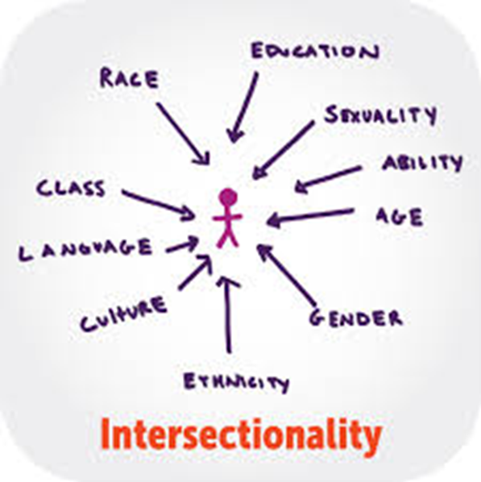
But its Intersectional
“[ As a black woman] I face discrimination as white women but also as a black woman. Similar, different and unique discrimination”
I was constantly discriminated against because of my poverty and those wounds still run very deep...[But] The concept of intersectionality recognizes that people can be privileged in some ways and definitely not in others." ~Gina Crosley-Corcoran
DIS
RELIGION

Slide 10
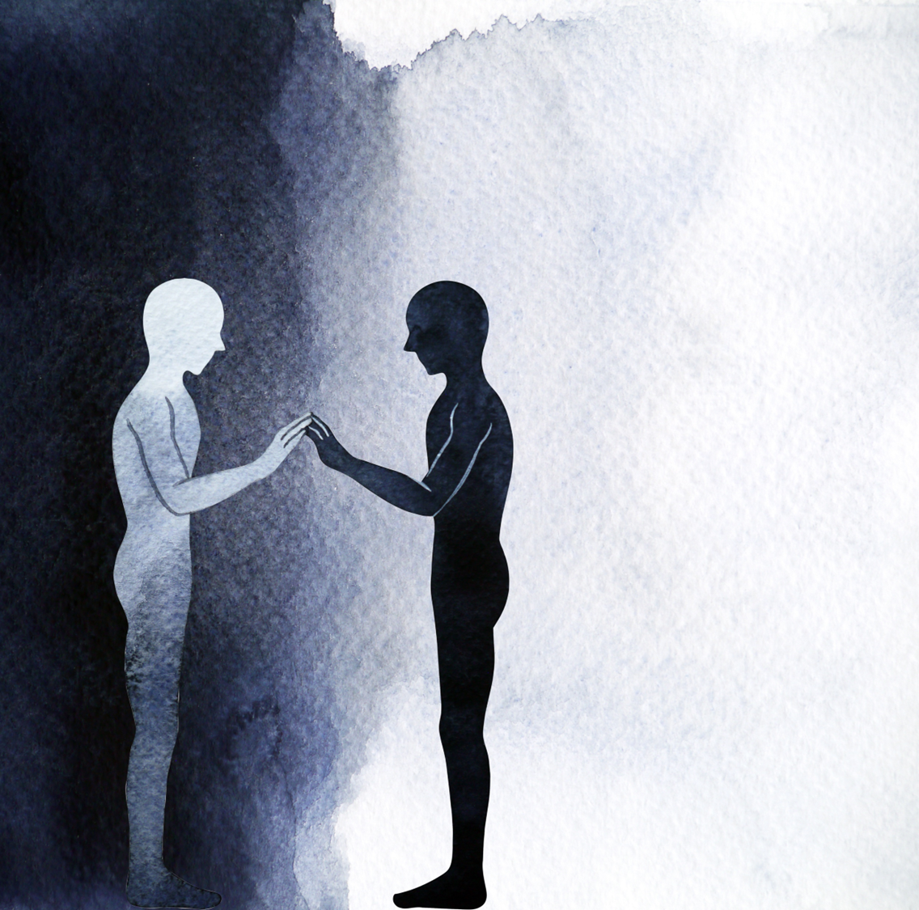
Othering, In-group, proximity & depth
“I don’t feel I ever get listened to. Every time I tried to talk people nod and just carried on as normal” (Personal Level Othering)
“I entered the conference I could feel everyone looking away as I arrived in my wheelchair” (Identity Level Othering)
What words describe Othering?
Alienation, Invisibility, Neglect, Angering, Lonely, Isolation, Shame
Notes:
When have you felt Othered?
When has power been used against you?

Slide 11
Spaces: Interactions & Participation
Identity (Affinity) Groups
Social Media Groups
Interest Groups
Social Groups
Extended Family
Religious / Spiritual Groups
Heritage
(Immersion)
Community Groups
Government Institutions
Family
Work
Private
Orgs
Exercise
Have you been Othered?
Have you had Power used against you?
Where do you belong?
(1-10 Scale)

Slide 12
5 Faces of Oppression (Iris Young)
Exploitation. E.g. Free labour.
Marginalisation. Societal Outliers.
Powerlessness (“I would have free thousands more, if they had known they were slaves.”, “No voice or will”)
Cultural Imperialism. Adopt culture of dominant class as best (e.g. colonisation, hetro-normativity, ableism)
Violence. Attacks, stereotypes and denigration.
Are these relevant to therapeutic practice? How? Any others?

Slide 13
What is Discrimination / Oppression?
HISTORICAL
CHRONO
Ideological
Interpersonal
Institutional
Internalised
Change
Power
The unjust use of power*

Slide 14
Example: helps us acknowledge discrimination and action change
Ideological
Validity is based on how present / pass as either a man or a woman
Disabled people are “tragedy” who need charity
Institutional
I can be reasonably sure that my impairment | race | name etc. will not discourage employers from hiring me
I can be reasonably sure that therapists will be able to understand mostly my identity, culture, and racial identity (dominant identities)
Interpersonal
I can, if I wish, arrange to attend social events without worrying if they are accessible to me | face social identity-based aversion or aggression
Internalised
I can’t apply for a job because I don’t feel my value
I experience accumulative trauma which makes ‘asserting’ myself unsafe
Infrastructure (MA Added)
Building and setup doesn’t provide access or safety

Slide 15
Oppression again..
Consequence of unchecked “entitlement, sanction, power, immunity and advantage or right granted or conferred by the dominant group to a person or group solely by birth right membership or prescribed identities (Black & Stone, 2005)
Privilege may be seen across all levels i.e. Structurally created rather than personalised to individual

Slide 16
The Case for Anti-Oppressive Practice in Therapy
A Psychological Practitioners Path for Embedding DD&A within Self & Practice

Slide 17
The Ever-Urgent Challenge
Need a therapist to look at the accumulation of trauma over decades in mental health care, medication, and living with multiple identities of oppression and grief. ND exhaustion, depression, and anxiety…
I’m Non-binary, Black, disabled, AFAB, queer & ND

Slide 18
Impact of Oppression
There is much evidence demonstrating that experiencing poverty, racism, classism, homophobia/heterosexism, ableism, islamophobia, antisemitism, ageism, sexism, social exclusion/violence due to spirituality/religion, and/or other forms of oppression, has detrimental impacts on the mental health of individuals, collectives, and communities
(e.g., Hatzenbuehler, Phelan, & Link, 2013; Lewis, Cogburn, & Williams, 2015; Livingston & Boyd, 2010; Pachankis, Hatzenbuehler, & Starks, 2014; Pascoe, & Smart Richman, 2009;; Williams & Mohammed, 2009).

Slide 19
LGBT+ Mental Health (Stonewall)
A worrying number of LGBT people have experienced depression (50%), anxiety, had suicidal thoughts or even attempted to take their own life in the last year. LGBT people are at a higher risk of experiencing common mental health problems than the general population.
Almost half of trans people (46 per cent) have thought about taking their own life in the last year.
Forty-one per cent of non-binary people said they harmed themselves in the last year
Disabled people x5 times more likely to experience mental health difficulties

Slide 20
LGBT & Mental Health (2)
One in twenty LGBT people (five per cent) have been pressured to access services to question or change their sexual orientation when accessing healthcare services.
One in five LGBT people (19 per cent) aren’t out to any healthcare professional about their sexual orientation when seeking general medical care. This number rises to 40 per cent of bi men and 29 per cent of bi women.
One in seven LGBT people (14 per cent) have avoided treatment for fear of discrimination because they're LGBT.

Slide 21
Structural Inequities: COVID Deaths
“the pandemic showed that ethnic minorities are up to twice as likely to die from Covid-19*, a pattern also reflected in higher diagnosis rates, hospitalisations and admission to intensive care units. The analysis explores the possible societal causes of these trends.”
Black people x 4 more likely to die (ONS)
63% of NHS Deaths based on 21% of workforce**
44% PoC Doctors make up 95% of all Doctor Deaths**
* https://www.youtube.com/watch?v=-2iB6UXFDlk
Notes:
https://www.manchester.ac.uk/discover/news/role-of-systemic-racism-in-exacerbating-covid-19-health-inequalities--examined/

Slide 22
Therapeutic Practice (1)
The structural feeds into mental health field and oppression
Balmforth (2009) therapeutic progress is hindered when class issues are ignored [ Therapist responsibility to raise ]
“[ PoC ] are less likely to access therapy, experience/present good outcomes, and more likely to report social exclusion and negative experiences in therapy compared to white majority service users. “
“Oppression experienced by disabled people in society is sometimes replayed in the counselling room by counsellors who are unaware of their own disablist attitudes and prejudices” (Reeves)

Slide 23
Evidence of Disparity vs. Feeds into therapeutic practice
Notes:
Talk about it through Access, accessibility, drops, outcome, experience/negative or harmful..
Age doesn’t reflect demographics
Dropouts
Harm/negative experiences
Gender identity diverse% an Sexual orientation %
Get more information..

Slide 24
Lots of issues can lead to personal Oppression too (Inc Stigma)?
Overmedicalisation
HIV
Domestic Abuse
Sexual Violence
Language
Appearance / Body
What else?

Slide 25
Summary
Group identity & personal oppression impacts mental health and body
AOP foundation helps visibility of self and clients through structural dynamics such as social positionality, power, contexts, privilege, and social identities
Deeper empathy and understanding of the client’s problem
Most vulnerable are not ‘hidden’ from view in practice (inclusion)
Focusing attention on barriers within the self, client systems, and the system of therapeutic practice
All-inclusive

Slide 26
Back up Session 1

Slide 27
END

Slide 28
Critique of EDI
Contrast EDI which primarily operates at the different level and improving relationships and begins to recognise disproportionality
Doesn’t feature power relational dynamics in relationships and structures as well as action praxis for change in systems
AOP with EDI conceptualizes problem at a deeper level

Slide 29
Session 2

Slide 30
Working with Difference, Diversity & Inclusion : Implications for Practice
A Psychological Practitioners Path for Embedding DD&A within Self & Practice

Slide 31
Learning Objectives
Aim: Understand how to begin integrating these ideas into practice particularly in working with Difference, Diversity, and Marginalisation
Objectives:
Review DD&A
Understand important AOP related concepts applicable when working with DD&A
How to integrate and conceptualize clients’ difficulties using AOP principles
Contact : admin@tadf.co.uk, learn.tadf.uk, twitter @tadffocus

Slide 32
Reviewing Difference, Diversity and Marginalisation
A Psychological Practitioners Path for Embedding DD&A within Self & Practice

Slide 33
Differences (Visible / Invisible / Voiced / Unvoiced)
What grabs you today? (Adapted SOCIAL GRACES)
Gender | Geography | Race | Religion | Age
Disability* | Appearance Body / Aesthetics / Expression * | Culture | Class/caste | Education
Employment | Ethnicity | Religion & Spirituality | Sexuality | Sexual orientation
Neurodivergence* | Citizenship* | Language* | Skin tone* | Relationship Style*
Home | Beliefs & Values* (Worldview) | Communication Preferences* | Sensing & Learning Style | Power Orientation

Slide 34
Basic Terms Used
Wider Societal Culture (WSC), Cultural Group (~Ethnic)
GSRD, Queer, CIS Gender, Trans*, Intersex
Neurodivergent (e.g. Autism, ADHD…)
‘Race’, Black, Multi-Racial
Disability / Impairment
Class
Dimensions: Visible / Non-Visible / Invisible / Voiced / Unvoiced
TIP: Individual decides labels
| Not everyone agrees or likes labels
Trans = gender not as per assigned at birth in trans men and trans women
Queer = gender / sexuality non-conforming
Intersex non-binary sex anatomy

Slide 35
What is an Anti-Oppressive foundation to DD&A in Therapy?
A Psychological Practitioners Path for Embedding DD&A within Self & Practice

Slide 36
Anti-Oppressive Practice in C&P
Anti-oppressive practice means that we take account of the impact of power, inequality, and oppression on people, and actively combat these (Nosowska 2014).
.. is an attempt to eradicate discrimination and oppression from our own practice and challenge them in the practice of others and in the institutional structures which we operate” (Thompson, 2018)
Enable clients to overcome the barriers they face (all levels including therapy)
Notes:
Tool: Anti-oppressive practice Anti-oppressive practice means that we take account of the impact of power, inequality and oppression on people, and actively combat these (Nosowska 2014). In supervision discussions, it is important that we adopt an anti-oppressive practice approach which includes: > Recognising the Personal, cultural and structural barriers that people face - Personal barriers are the way that personal characteristics are used to stereotype or limit people - Cultural barriers are the way in which we are socialised to think of some people as normal and others as not - Structural barriers are the way that we set things up to make it easier for some groups and harder for others > Recognising our own characteristics and our own place in the culture and structure – and how this might impact on someone > Working to understand someone’s experience of oppression, understand and appreciate their attributes and contribution, and empower them to realise their rights (Thompson 2016). A useful question to ask is: What is holding this person back? This tool helps you to consider the oppression that may be experienced by people that you work with. You can use this in individual or group supervision to discuss the barriers people face, the impact on them and the impact on your relationship. This will help you to plan how to engage with them in an anti-oppressive way. That is, to enable them to overcome the barriers they face.

Slide 37
Implications for Practice
How do we and the profession serve ALL and treat ALL with equal value and respect?
Anti-oppressive practice
Client
Therapeutic Practice (You With Client)
Service Design (Front door)
Mental Health Eco-System (Interdependencies)
Organisation
(Policy / Training etc.)

Slide 38
EDI needs Anti-Oppressive Foundations
Contrast EDI which primarily operates at the different level and improves relationships and begins to recognise disproportionality
Doesn’t feature power relational dynamics in relationships and structures as well as action praxis for change in systems
AOP with EDI needs to conceptualizes problem at a systems level

Slide 39
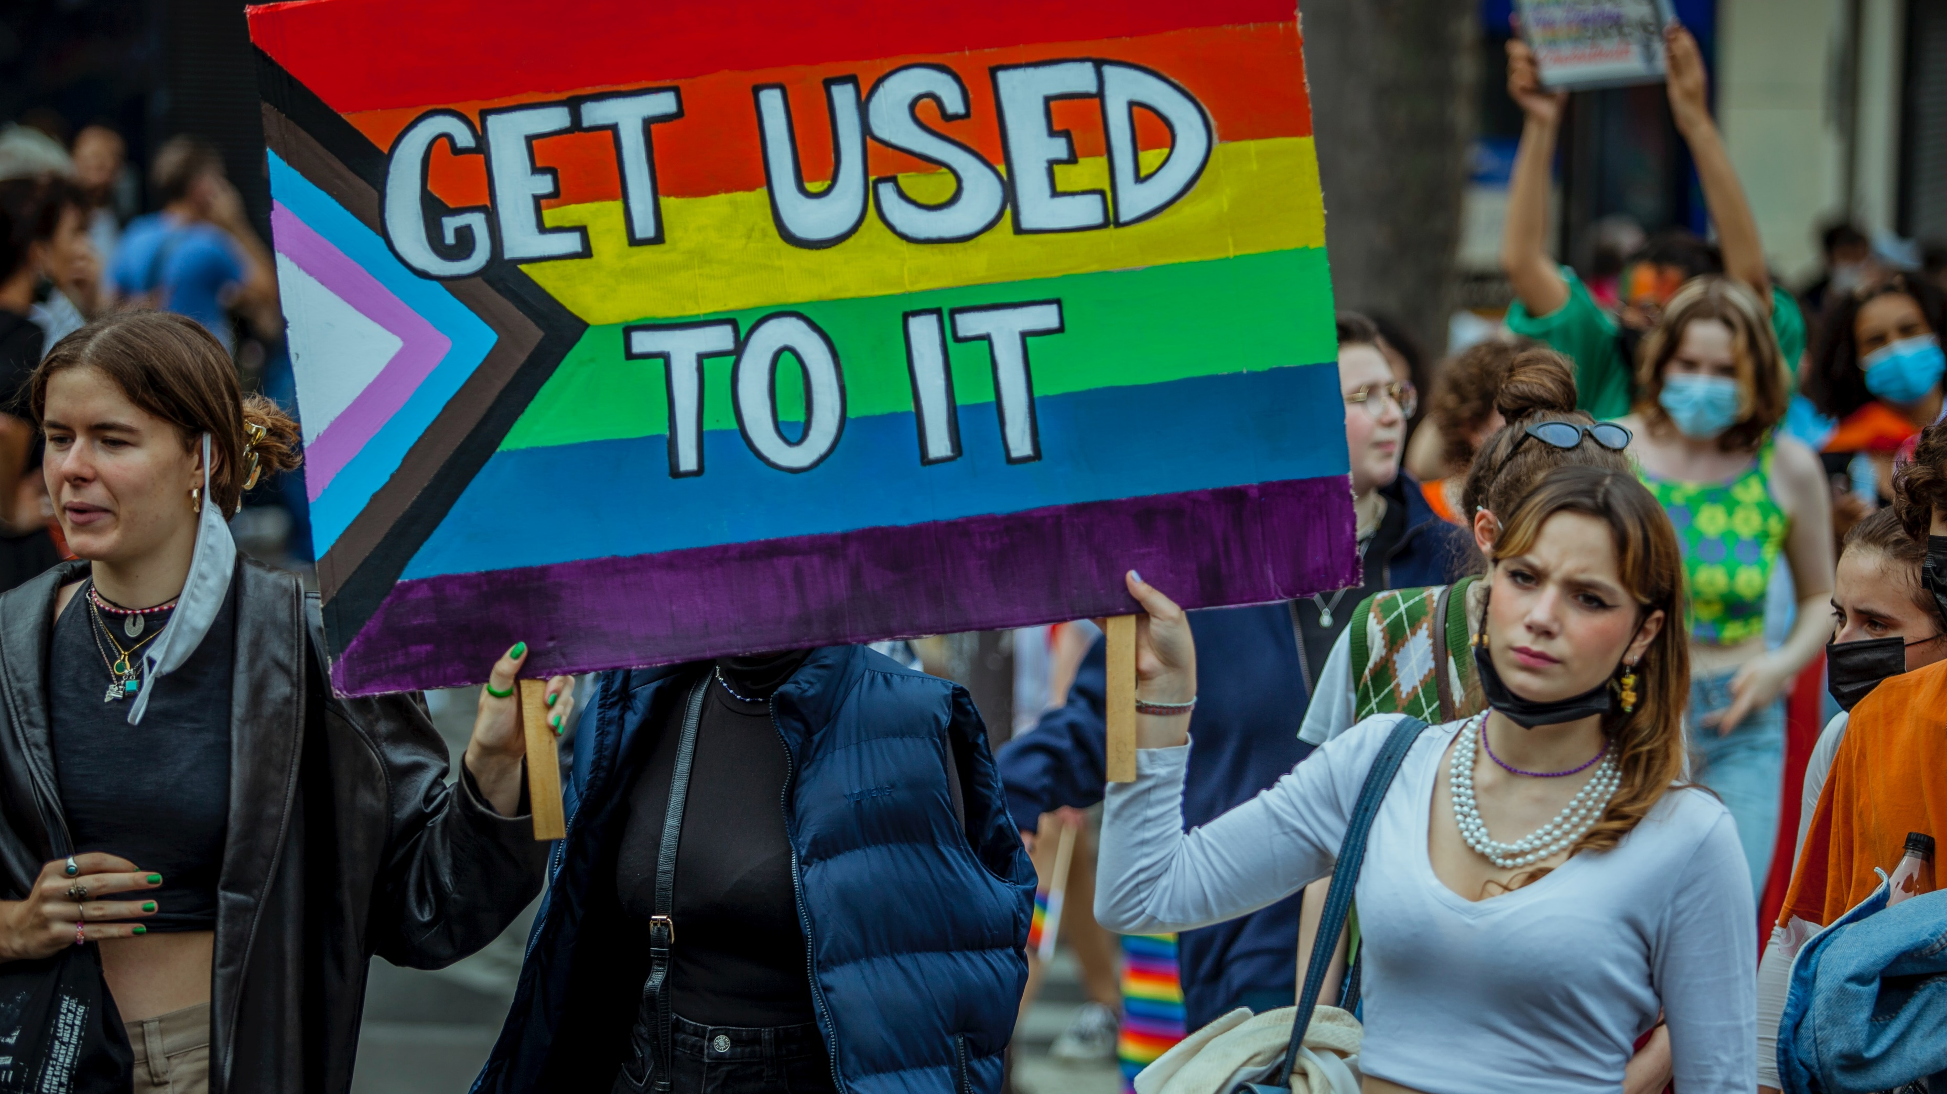
Building Blocks for working with DD&A

Slide 40
AOP in Therapeutic Practice
Unique Experiences Link to
Social Identities & Positionality
Intersectionality
Within Contexts
Within Society
Within Planet

Slide 41
It is Systemic (* Image created by Inclusion London)

Slide 42
Key Concept: Group Stress & Trauma
Language
(Verbal/Non)
Chronic Stress
(Intergeneration &
Socio Historical)
Emotional Pain
(Hostile, Aversive, Aversive-Hostile)
Structural & Systemic Levels
Ambiguity
Coping
Adapted Racial Trauma & Minority Stress Models (Adapted Kniffley, 2021, Meyer, 2003, Carter, 2020)
Trauma may not be explained by physical trauma, PTSD criteria but emotionally painful
Microaggressions: Adaptive coping vs Experience of stress / exhaustion
Chronic stress: lifespan and Intergenerational / Historical
Structural: Needs not met by system
Ambiguity: Structural, macro, micro, interpersonal gaslighting
Internalisation
Cycle of above

Slide 43
Key Concept: Relational Power, Bias & Blindspots
Racism & Sexism
Power risks =
Bias
Cultural bias
Embedded theory
Morality bias
Knowledge dissonance
Assimilation
Client
Western Culture
Client
Culture x
BIAS
BLIND
Therapist Vantage Point
ALLIED
POWER
Antidote=
Competence + Cultural humility =
Leap of faith
Therapist
Therapist
Theory/Approach
Western Culture

Slide 44
Key Concept: Risk to Understanding & Empathy
Therapist needs to expand awareness of relationship and content from a wider vantage point relative to own identity e.g. European Culture vs. Arab Culture / NT & ND / All
Therapist
Identity
EMPATHY GAP (COMMS / UNDERSTANDING)
Client
Identity
Therapist
Client
E.g. I don’t give advice
Nuclear family focus
E.g. Silence is not caring, Extended family focus
Relational Tension / Empathy Gap vs.
Adaptation & Awareness
Notes:
Give an example e.g. assertiveness or financial burden

Slide 45
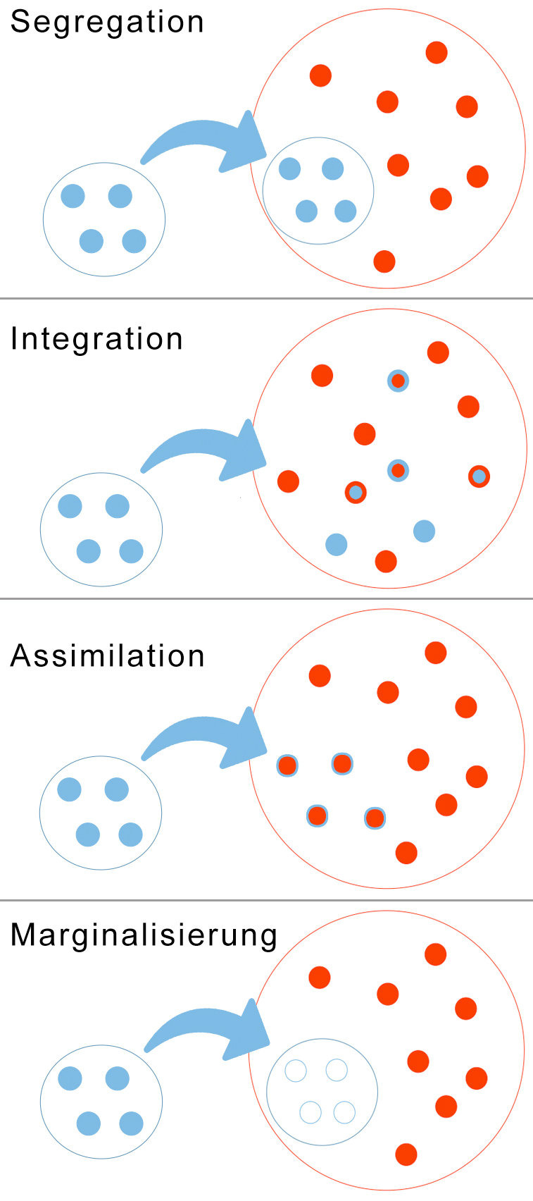
Key Concept: Acculturation
Exclusion. Excluded from system and power.
Inclusion. Included without sharing of power.
Integration. Can exist within, be in the centre and be separate from dominant group. No visible boundaries/barriers. Expansive meaning of being human. Requires dominant group to share power. (Mutuality, care, respect)

Slide 46
Key Concept: Normativity
Privileged/normalised group seen as normal, preferred, correct, right and the standard by which to judge anything else (culture, values, behaviours, knowledge)
Often leads to invisible value system within dominant “normalised” identities
Normativity can be also seen as the bias, stereotypes and prejudice “projected” into the Other
Examples: Eurocentric, hetero-cis–normativity, neurotypical, communication and learning styles, professionalism

Slide 47
Key Concept: Universalism
Any approach designed around dominant group and deemed “universal” or fitting everyone
Proverbial “Square hold round peg”
“Treating everyone the same isn’t treating everyone the same”
Creates barriers and often “blame the group”
E.g. Eurocentric approaches to therapy, theories, Trans healthcare.

Slide 48
Key Concept: Culture Bound
We are encultured by Wider Societal Culture(s)
How we perceive, live and design our lives can often link to Culture (thus Culture bound)
Examples: Preference to individual independence, rationality vs human experience (e.g. over medication/ diagnosis), preference for strict time, boundaries, and individual therapy, mind-body split, cisgender, communication preferences,
Reflect on how I have been encultured? How is the profession culture-bound?

Slide 49
Key Concept: Nothing about us without us
Historically objectified as the “Other”
Centering those groups being “discussed”
Reflects need for voice in all aspects of life e.g., policy, law, film, research, training, etc..

Slide 50
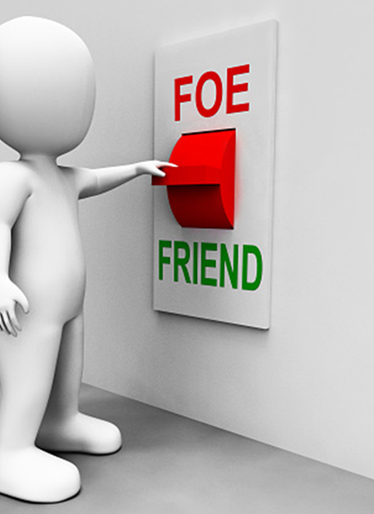
Key Concept: Cultural Humility
Limited knowledge can be garnered without lived experience
Acquiring and applying knowledge can be Othering and not a reflection of uniqueness of individuals or their cultural group
Therefore, draws upon client's cultural context and personal worldview which maybe similar -> very different to your understanding
Antidote to power. Disarm the therapist as “a threat”, or “won’t get it” narrative
Does not mean no cultural competence needed
De-risk ‘power over’ and eurocentrism as the right way
Strong evidence base

Slide 51
Key Concept: Identity Affirming Practice
Client-centred and identity divergence affirming
Client as expert and cocreator (including approach, method, interventions)
Space to explore identity, meaning and choices
Not a push either way
Will embrace the difference if chosen
Strength and Trauma Informed
Mindful of assimilation / bias / pathologizing identity
Notes:
The main principle of #neurodiversity affirmative #counselling and therapy is that we do not seek to correct or change a person’s inherent neurodivergent traits. We don’t see neurodivergence as deviance, defectiveness or pathology. Neurodivergent struggles, including anxiety and trauma, are not, as is often implied, caused by bad behaviour, failure to fit in or comply with various norms and demands. They are exacerbated because of said rigid norms and demands and a lack of understanding and accommodations. Does that mean we neurodivergents hold no responsibility for how we behave and treat people? Absolutely not. But there is no affirmative therapy without acknowledging structurally inbuilt and internalised ableism and its impact on a ND nervous system. An affirmative therapist should be able to adapt to and understand your ways of expressing yourself, acknowledge neuro-difference in the room openly, be curious and open to learning, though not expect you to educate them fully on your particular neuro-difference. Neurodiversity affirmative therapists CAN be neurotypical - the therapist I had for 2 years was NT and was awesome, but we also acknowledge that shared lived experience may be significant for therapeutic alliances. It’s ok to ask about professionals’ lived experience of ND. Lastly, here are some very non-affirming to look out for. - Dismissing your diagnosis/need to explore neurodivergence as a possibility - Not considering ND valid if it’s not medically diagnosed - Refusing reasonable accommodations - Suggesting ND can be corrected or cured

Slide 52
Relationships are not neutral meetings Pre-Rupture / Fractured (Ahmad, M) Pre-Transference (Curry, A) Societal Transference (Curry, A)

Slide 53
Therapy has great promise with AOP Foundations
Therapy considers power dynamics
Therapy understands ‘what’s in the room and outside (and vice versa)’
Recognises benefits of awareness (unconscious to conscious) e.g. blind spots
Considers personal history transference (identity transference)
Considers the “real self” organism self (collective organism)
Considers personal empowerment (via voice) with acceptance/justice dynamics
AOP extends this model to the world and our practice/profession with the integration of social intersecting identities

Slide 54
Could these moments be Oppressive? How?
The client had been waiting a long time for a diagnosis. They had recently been diagnosed and the client had mixed feelings about it to which the therapist expressed “I hear your confusion and I just wanted you to know that regardless I see you as you, as Michael”
The therapist told a prospective disabled client they didn’t have wheelchair access so “sorry could not meet their needs. Good luck”.
Counselling is generally considered a white middle-class profession (Ballinger 2017). Why would this cause oppression?

Slide 55
Summary
Building blocks of DD&A help us gain a deeper understanding of clients’ social-cultural impact, develop ourselves, and conceptualize client difficulties including the therapeutic relationship
We see the uniqueness of the individual

Slide 56
Models of Health (Profession, Client, Society): Differential Lens to view Individual Difficulties (Dominant View, Therapist View vs Client View)?
Bio-Medical – Fix to make ‘normal’
Psycho – Fix self to cope / client growth
Body – Heal the body
Structural – Society needs to be fixed (Identity Affirming model)
Intergenerational – Intergenerational Healing
Spiritual – Spiritual affirmation / deficit
Moral – Punishment for deeds e.g., karma
Tragedy – Perpetual Victim (seen as needing help) – Societal Model
Culturally Led – Group knowledge led e.g. Ethnocentric, Eurocentric
Risk: Safety aware but not of what's helpful to client..
Notes:
Historical – Historical healing
Structural – Structures need to be fixed (Ideological/Institutional)

Slide 57
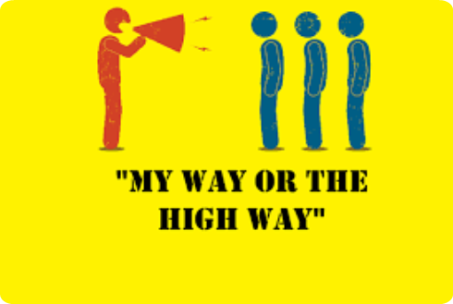
Key Concept: Assimilation / Conversion
People who are marginalised by necessity or indoctrination are expected to fit into “normalised” standards to participate
Examples: Conversion therapy, Communication Style, CodeSwitching, Cultural conversion, Neurotypical Style, Eurocentric values, Gender conformity, conversion therapy
Implications for Internalised Oppression

Slide 58
Acculturation
Assimilation / Conversion: Groups may by need to fit into dominant group. By necessity, survival or “social pull” to and fit in. Assimilation by “stealth/force/necessity”.
Examples: GSRD, values and beliefs, Eurocentric values, masking.
Segregation: Separation of groups. Outliers may by necessity seek alternative means to survive and/or spiral. Or be forced out.
Marginalisation. Marginalised by dominant and own group.

Slide 59
Key Concept: Culture Bound
We are encultured by Wider Societal Culture(s)
How we perceive, live and design our lives can often link to Culture (thus Culture bound)
Examples: Preference to individual independence, rationality with regard to human experience (e.g. over medication/ diagnosis), preference for strict time, boundaries, and individual therapy, mind body split, cisgender, communication preferences,
Reflect on how I have been encultured? How is the profession culture-bound?

Slide 60
Key Concept: Nice Narratives
Normative (parts) of a person may seek comfort in being “nice” as a defense
Nice may be a mask for internalized discomfort
Issue: Retains power position by appeasement/diplomacy/ minimal participation rather than work/action
Examples: It’s hard for this group, difference blind / just human, value-free therapy, fear being called out, no internal self-development, diplomacy, externalizing issue to others, emphasis on reading, trauma porn, inspiration, I should be the exception to the “awful” rest.

Slide 61
Storyboard
1: Context: What and why and its overall meaning to us?
2: Practical Implications for working with DD&A
Role Play
3: Embedding AOP into Practice

Slide 62
END Session 2

Slide 63
Session 3

Slide 64
3. Embedding DD&A withing Self, Practice and Profession
A Psychological Practitioners Path for Embedding DD&A within Self & Practice

Slide 65
Learning Objectives
Aim: Understand how to begin integrating these ideas into practice
Objectives:
Reflect on overarching principles of practice (what it is not and pitfalls)
Understand how these concepts can be used ecologically (system of therapy)
Help you position your next steps of development
Contact : admin@tadf.co.uk, learn.tadf.uk, twitter @tadffocus

Slide 66
Therapeutic Principles for DD&A

Slide 67
Overarching Practice Principles
Accountability & responsibility (including Humility)
Exploring identities including historical and geographical
We suffer in context (socio-political-economic-group-individual)
Understand the risk of re-enacted trauma in the room
Client identity affirming – knowledge, worldview, identity
Committing to addressing oppression (All levels room and outside of it)
Therapy is for people not a subject of itself
Notes:
https://pacja.org.au/2020/12/anti-oppression-psychotherapy-an-emancipatory-integration-of-intersectionality-into-psychotherapy-2/

Slide 68
The Ever-Urgent Challenge
Need a therapist to look at the accumulation of trauma over decades in mental health care, medication, and living with multiple identities of oppression and grief. ND exhaustion, depression, and anxiety…
I’m Non-binary, Black, disabled, AFAB, queer & ND, Gamer

Slide 69
Reflections
How do you feel about being equipped to help this client? (What’s your gut response)?
How “identity” different are they from your own? How could this impact the relationship?
What dimensions of client experiences would you need to learn more about?
What is the risk to you re-traumatizing this client? How and why?
Notes:
Have you had a client talk about identity in these explicit ways?
Why do you think the client is describing themselves in this way?

Slide 70
Are Men’s Mental Health Issues Interconnected to Oppression?
“Man has to wear a mask very early on in their indoctrination. He must behave according to cultural rules entrusted in him. Being stoic, giving up on emotions, and often ruthlessly competing to rise to the top. He must give up on authenticity, longed for identities, potential for love and connection in [ adaptive ] favour of status and power.”
What happens when they do not meet those ideals of “man enough?”
Samaritans' Men and Suicide report, shows how complex the issue is. In the report, men talk about relationships breaking down, separation from children, job loss, addiction, lack of close friendships, loneliness and being unable to open up.

Slide 71
All issues are interconnected?
“If you have come here to help me you are wasting your time, but if you have come because your liberation is bound up with mine, then let us work together.”
― Lilla Watson

Slide 72
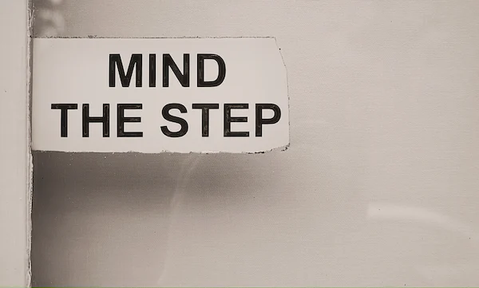
Common Therapist Pitfalls
Difference invisible
Client education – Empathy enough
I don’t have clients of Group/Intersections of A, B, C
Adjustments aren’t reasonable
Not ‘safeing’ the client (reflection & accountability)
Strict boundaries / Not Strict boundaries e.g. time/cancellations disabled clients
Strict Interpretations (hold assumptions lightly) esp. about marginalisation experiences

Slide 73
Common Therapist Pitfalls
Not becoming aware of the relationship dynamics
Doubting of lived experience (choice / freedom / embodied experience)
Conversion: You will be accepted if x (assimilation, conversion, cisgender)
Blaming group. Why cant you fit in? they just don’t go to therapy
Pathologising / infantalising. You need to think about it differently! We will let you know what to think.
Mislabelling / language e.g. misculture/misgender, first person
Tropes
Not doing the work

Slide 74
What AOP in therapy is not
Telling the client the “right way” to think about their identity or labels
Withholding knowledge (voluntary informed consent) e.g. psychoeducation / signposting
Against ethical methods of help e.g. medication, solution centred work, multi-disciplinary teams
Having an agenda / over-identification with AOP
Not seeing shared and unique aspects of being human
Replacement for specific group & intersectional competencies
Not celebrating difference and diversity (affirming identity)

Slide 75
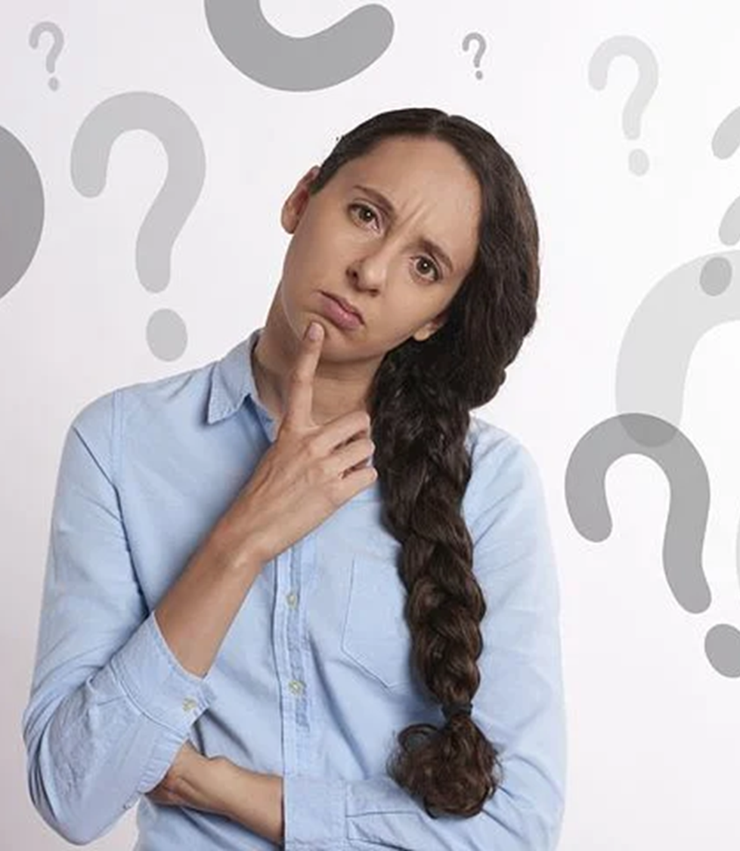
Anti-Oppressive Therapist vs Non-Oppressive Therapist?
From just “people are people” to power, privilege, positionality of intersectional identities
From Diversity/Difference, Cultural Competence to Antidiscrimination / Anti-assimilative
Active in recognition of impact of inequality/-isms on mental health
Remember the power of the healing relationship
Advocate in action (e.g., within Profession)
Notes:
Ask audience what they think

Slide 76
Therapist Readiness (Adapted Day-Vines, 2007)
Avoidant
Neutral and everyone is human (ignore outside society and what they ‘see’)
Isolating
One and done
Not part of overarching consideration
Continuing/ Congruent
Anxious/Want to work effectively but unsure
Not integrated
Infusing
Integrated/
Congruent
Effective and integrate into professional way of working and ongoing development
Way of life mirrored into personal life with commitment to AOP (It is who I am and how I see the world).

Slide 77
The Path: Tools, guides and maps. Are you Ready?
Open to Reflect
Open to Learn
Theory
Reflection
Action
Open to Act
PRAXIS
Open to discomfort
(Experiential &Body based)
Notes:
Take mask off be authentic and whats feeling, what happened.

Slide 78
Embedding Ecologically within Therapy
A Psychological Practitioners Path for Embedding DD&A within Self & Practice

Slide 79
Implications for Ecological Practice
How do we and the profession serve ALL and treat ALL with equal value and respect?
Anti-oppressive practice
Client
Therapeutic Practice (You With Client)
Service Design (Front door)
Mental Health Eco-System (Interdependencies)
Organisation
(Policy / Training etc.)

Slide 80
The Externals of C&P
Big / Small Suppliers / Influencers / EAPs
Your Profession
Theories & Approaches
Training & Supervision
Wider MH Profession
Medicalisation,
Regulation,
Professionalisation & Standards
In Practice
Supervision
Applying DD&A Principles in any sphere of helping needs historical and cultural lens..
What is the impact on clients from marginalised groups?
What change is needed?
Therapist
Client
Socio-Political-Economical
Future ? -------------→

Slide 81
C&P Domains of Practice : Embedded throughout
Supervision
Research
Therapy Practice
Service Design
Organisation Design
Self-Dev & Awareness
Training
Ethics & Competencies
Theory
Relationship
(Different Contexts)

Slide 82
It starts in training..
“We want the best students doing our counseling and psychotherapy training in our training institutes we need people who are academic and have a research background with the ability to think in psychological ways”
“Your written English isn’t great. How will you be a therapist?”
“During our interview, we felt you weren’t able to show empathy. We don’t think you will fit the bill”

Slide 83
What are some challenges to Inclusion? How are they manifested (Examples)?
Emphasis on medication and diagnostics
Middle-class normative identities represent normative cultural experiences
Training reproduces minimal priority to DD&A training
Access is long/limited and private therapeutic care isn’t affordable
There is evidence and risk that therapeutic practice can mirror societal marginalizing and exclusionary experiences ( access, experience, and outcomes )

Slide 84
Example Studies within the Ecosystem (Source PACJA)
Effects of Eurocentric therapy in psychotherapeutic methods, techniques, professional standards, and training
Effects on Access due to lack of diversity in theory
limitations of techniques and interventions based on dominant cultural assumptions (e.g., assumptions about “attachment” and “co-dependency” based on individualistic, ethnocentric, beliefs about human relationships);
pathologizing of natural human diversity and emotional distress due to injustice and systemic oppression (e.g., when spirit possession is classified as a psychiatric disorder in ICD and DSM diagnostic frameworks);
evidence-based recommendations for ensuring the inclusion of [ Diverse] perspectives and forms of spiritual and cross-cultural diversity in mental health services standards; and
critically evaluating how discourses of “evidence” base can be used in oppressive and exclusionary ways to privilege or silence marginalised peoples and lived experiences.

Slide 85
AOP Charter: You decide?
In all of my efforts to collaborate for change, I value relationships, and approach my work with respect for all people. I strive in both my perspectives and practices, to challenge racism, sexism, homophobia, and oppression in all its forms.
What will you change in practice from today?
Notes:
Anti-Oppression Principles — Center for Story-based S
I challenge power structures at all levels. I am committed to becoming a better ally.
Holistic Analysis
Analysing Power
Undoing Oppression
Listening
Acting
Appreciation and Gratitude
Leadership
Networking
I am committed to being a visible ally.
trategy (storybasedstrategy.org)

Slide 86
#TADF
#TADF is for anyone who wants far more ecological inclusion within the mental health professionals such as those who have been historically or situationally marginalized because of their race, religion, ethnicity, sexual and gender diversity, neurodivergence, disability, language, citizenship, class, and socio-economic status. #TADF is for collective healing, relational restoration, and structural health.
Focus is currently on root change within the psychological and C&P curriculum

Slide 87
#TADF: DD&A Learning Framework
9. Co-Creation : Approach, Knowledge & Healing
3. Social Location
4. Worldviews
8. Visibility, Adaptation & Acculturation Conflicts
6. Cultural & Systemic Contexts
10. Identity Development
11. Structural Narratives, Stress & Trauma
12. Empowerment & Justice
7. Relational Development & Pre-Ruptures
5. Power, Barriers & Facilitators
1. Healing approach ( Therapy Modality, Indigenous, etc.. )
2. Assessment (Self & Client)
AOP
Principles
Culture
aware
+/-Balance
Notes:
Power, Barriers & Facilitators
Push, Pull & Balance = is harmful otherwise
Therapist is within their cultures
Structural = 4 xis, internal isms, oppression, structural, intergenerational, stress / trauma, historical etc..
All layers are interrelated not one at a time..

Slide 88
Certificate in Culture, Diversity, Race & Anti-Oppressive Practice (Learn.tadf.uk) – BACP10

Slide 89
TADF DD&A Available freely* to all Lecturers / Institutes
* Subject to fair donation

Slide 90
Summary: To Practice in Colour
Beyond People and Problems
Structural (Thus Cultural) Informed
Identity & Positionality Informed
Relational (Difference)
Trauma Informed
Worldview Informed
Blended into all aspects of clients’ unique experiences thus problems, relationships, strengths, and solutions

Slide 91
Contacts
Mamood Ahmad
admin@tadf.co.uk
Learn.tadf.uk | tadf.co.uk
Certificate training
Book published 2023 C&P Embedded Practice
01344-723151
@tadffocus (twitter)
@ahmad_mamood (twitter)

Slide 92
END

