Slide 1

BACP CYP&F conference 22/02/20
Family Group: Supporting schools, strengthening families, enabling change.
Bridget McCabe – Integrative Child & Adolescent Psychotherapist
with
Aimee – VJS Family Group
Eloise – VJS Family Group
Supporting schools, strengthening families, enabling change

Slide 2
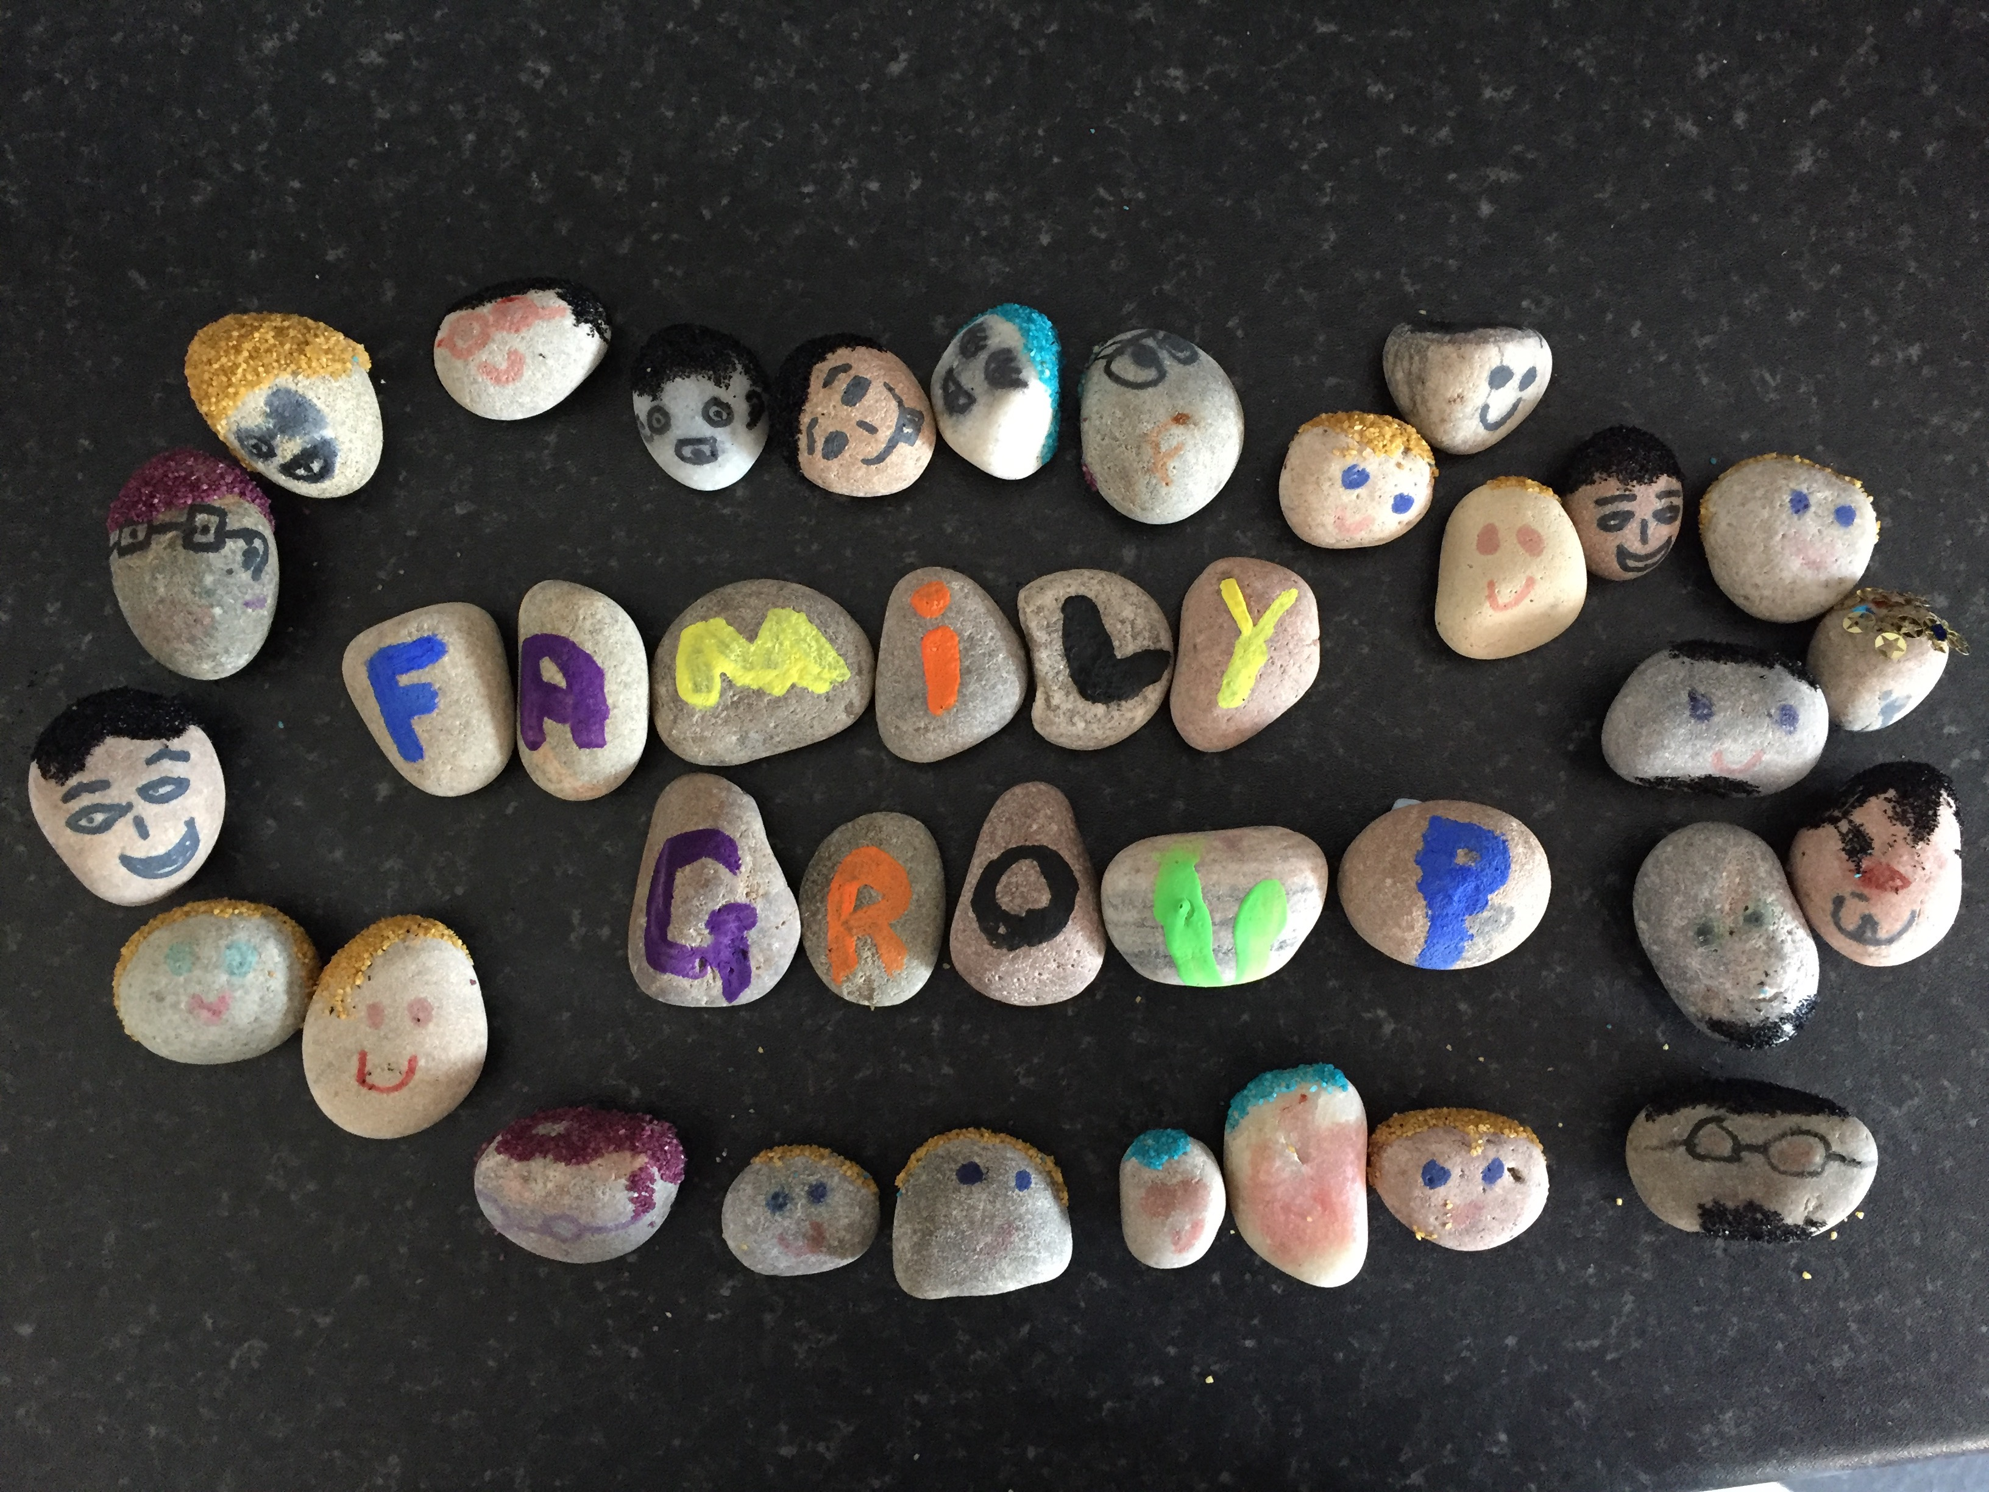
INTRODUCTION

Slide 3
Session Plan
What is Family Group? The model, the lineage, the evidence base & impacts
The user voice: why FG works
Q&A

Slide 4






















Slide 5


Slide 6


Slide 8


Slide 9


Slide 10
Lineage & evidence base
Asen, Dawson, McHugh at The Marlborough Family Service, St John’s Wood.
MMFTGs in ECM / Aiming High (2007) / New Horizons (2009)
Morris et al ‘Families changing families: The protective function of multi-family therapy for children in education’
Clinical Child Psychology and Psychiatry 0(0) 1–16 , 2013
Notes:
The work of the Marlborough Family Education Centre has been cited as an example of good practice in several government documents including:
Every Child Matters DfES (2003) "(It)...tackle(s) barriers to learning by focusing on repeating cycles of disruptive behaviour. Each child has measurable behavioural targets on areas such as anger and stress management, which are rated every day by parents, the class teacher and pupils themselves." (Every Child Matters, p44)
Aiming High for Children: Supporting Families: DSCF & HM Treasury (2007)
The Centre is presented as a case study on the website accompanying
New Horizons – A Shared Vision for Mental Health: DoH (2009)
Marlborough Multi-Family Groups, developed by Neil Dawson, Brenda McHugh and Eia Asen have also been featured in the TES, Teachers’ TV, and on the BBC’s QED programme.
Neil Dawson and Brenda McHugh were 2008 NHS Innovations Award winners for Mental Heath.
Morris: Outcomes for 50 families receiving intervention from the MFEC were compared with a control group of 28 who had access to a range of interventions, but not the multi-family group approach pioneered by the MFEC. Data on child and family social, emotional and behavioural functioning were collected at the point of referral, and at 6 and 12 months. Parents of children receiving support from the MFEC reported statistically and clinically significant improvements in their children that were maintained at 12 months whereas there was no change in the control group. In addition, measures of family functioning were fairly stable for the MFEC group, while the control group showed significant deterioration over the same time period.

Slide 11
SFW Family Groups
Mark Griffiths trained with Neil Dawson & Brenda McHugh.
SFW founded in 2009, with launch March 2010
Paul Hamlyn Foundation commissioned 3 groups for 3 years (June 2010)
Office for Public Management appointed to evaluate the project
Project Oracle accreditation at Level 2 (Feb 2013)
Evidence Award winner for Project Oracle (June 2014)
In Sept 2020 SFW will be working in 13 schools in SW London boroughs (KS1&2, mainstream, MLD & SEMH)
Logic Model
Handbook – Family Group in a Box
Theory of Change
Cabinet Office funded LSF project in 2016/17: revised logic model with UCL & expert adviser; Moira Forrester research project; new business plan
Notes:
At SFW we use four healing phases to enable transformational change, based on Kepner’s 1996 Healing Tasks model.
Make a safe enough space to support change
Develop the resources & capacities required to manage experiences and interactions
Undo the old, re-do with new, let go of losses
Enable integration, assimilation & growth

Slide 13
OPM on Impacts after a 3-yr evaluation
‘The impacts of Family Group have been uniformly positive and families and schools both strongly endorse the intervention. This is demonstrated in the fact that all three participating schools intend to continue funding their Family Groups after the end of the PHF funding. It is also evident in the willingness of many parents to promote the intervention, by encouraging other parents to join, sitting on the project steering group and volunteering to participate in the evaluation.
Parent –child relationships are improved
Children experience improved emotional wellbeing, behaviour and learning
Schools report improved relationships with parents and children
OPM 2014
Notes:
The impacts of Family Group have been uniformly positive and families and schools both strongly endorse the intervention. This is demonstrated in the fact that all three participating schools intend to continue funding their Family Groups after the end of the PHF funding. It is also evident in the willingness of many parents to promote the intervention, by encouraging other parents to join, sitting on the project steering group and volunteering to participate in the evaluation.

Slide 14
Children are better able to…
Manage anxiety
Seek help
Trust and build relationships
Learn
Understand the boundaries
Dr Mary Richardson, UCL Institute of Education, 2014
Notes:
Improve understanding of boundaries and the ability to manage them

Slide 15

Family Group helps parents to…
Feel safe
Feel heard
Form trusting relationships
Grow in confidence
Learn new skills
Understand
their children’s needs/anxieties
Manage rather than react to challenges
Dr Mary Richardson, UCL Institute of Education, 2014
Notes:
Form trusting relationships
Provide a structured forum where they feel heard and have direct access to senior leadership
Attune to their children’s needs/anxieties
Support parents to be boundaried and consistent

Slide 16
Family Group helps school to…
Build Communities
Improve relationships with families
Access expert advice & training
Understand how to help
in difficult circumstances
Look at alternative methods of teaching
Encourage teamwork
Dr Mary Richardson, UCL Institute of Education, 2014

Slide 17
Keys to success
Safety first
Partnership
Co-productive ethos
Families helping families
Open-ended
Outcome-focused / Target driven: practical
Experience of containment
Experimental: relational capacity is enhanced
Analytical and reflective
Systemic
Voices from Family Group
Notes:
Progress measured against concrete, staged targets, mutually agreed by child, teacher & parent and directly relevant to success in school. Targets are reviewed weekly.
Experiential – offers an experience of containment
Relational capacity is enhanced – through group interaction, modeled approaches, therapeutic input
Reflective capacity is developed – as reactive behaviours (often linked to unresolved trauma) are explored and understood, choice becomes possible.

Slide 18
Session Plan
What is Family Group? The model, the lineage, the evidence base & impacts
The user voice
Aimee & Eloise
Our Theory of Change
Q&A

Slide 19

connected up internally
articulate
secure
engaged
‘safety in relationship’ has not been experienced
empathic
rational
present
compassionate
Rules, laws, boundaries have not protected me
Brain chemistry – overload of adrenalin, cortisol
Reflective
dissociated
rigidified
resilient
reliable
Unable to read physiology of self or others
contained
Incoherent narrative
An experiential therapeutic journey creating new neural pathways
processing
learning
Passively aggressive
interdependence
overwhelmed
controlling
At SFW we use four healing phases to enable transformational change, based on Kepner’s 1996 Healing Tasks model.
Make a safe enough space to support change
Develop the resources & capacities required to manage experiences and interactions
Undo the old, re-do with new, let go of losses
Enable integration, assimilation & growth
traumatised
bullying
worthless
Reactive
avoidant
I don’t belong. I’m on my own.
don’t care. / I have to look after myself
STUCK
confrontational
provocative
frightened
Hyper-vigilant
Withdrawn
impulsive
UNSAFE
‘Leaking’
Insecurely attached – don’t or can’t feel ‘held’ in relationship
distorted
Where am I? Who am I? What time is it?
‘At large’ - Boundaries perceived as fetters
Isolated – or disconnected

Slide 20







Supporting schools strengthening families enabling change
THANK YOU

Slide 21
Thanks for coming
bridget@broadtalk.com
07909 931773
http://theschoolandfamilyworks.co.uk
Follow us on
https://twitter.com/SFWchange
Family Groups in Feltham are accredited by GLA Project Oracle as Level 2
"A project validated at level 2 has provided, in addition to a coherent and plausible programme model, a clear evaluation plan that measures relevant project outcomes in an appropriate way. Further, a level 2 project has provided evaluation findings that indicate that the project has a positive impact."

