Slide 1
Counselling Children &Young People in Care Trauma & Resilience
Joy Stewart Child Therapist
Based at MYRESET Counselling (Private Practice) &
Beyond The Horizon Charity
This Photo by Unknown Author is licensed under CC BY-NC

Slide 2
Aims & Objectives
To consider how trauma and attachment intersect and impact upon the resilience of children in care.
To explore the role of resilience within therapy provided to children in care.
To consider how we work with foster carers and children in care.
This Photo by Unknown Author is licensed under CC BY-NC-ND

Slide 3
Trauma
Professor Bessel Van Der Kolk stated “The single most important issue for traumatized people is to find a sense of safety in their own bodies..” The Body Keeps The Score: Brain, Mind & Body in the Healing of Trauma. (2014)
Judith Herman believes that..
“Recovery can only take place within the context of relationships: it cannot occur in isolation”
Social & Relational Sources of Resilience Herman(2002).

Slide 4
Let’s begin by meeting a family
Annie
29
James
30
Tia
12
Amy
27 months
Jordan
6

Slide 5
Case study – children’s journey through care
Tia, Jordan and Amy are the birth children of Annie and James.
They have been in the care of the local authority for 14 months after a disclosure from Tia to a friend at school that Dad has been hitting mum and she was scared to go home.
Previous concerns included anonymous referrals regarding parents fighting in the home and school reporting low attendance.
When a social worker came into school to meet Tia initially she would not talk. A few weeks later after a further disclosure was made to a friend. Tia then agreed to tell a teacher. She said Mum and Dad were always arguing and fighting. Tia also disclosed that she got hurt a few times trying to pull dad away from Mum and that Amy was in mum’s arms as Dad hit Mum. She was becoming more scared to go home as Dad got so angry and shouted so loudly and Amy was always crying. She asked for help for Jordan and Amy.
The children entered care.
Notes:
Explain process of child’s disclosure – s47 (if necessary), s 20 parental agreement and then ICO if agreement withdrawn or s 47 enquiries lead to evidence of sig harm.

Slide 6
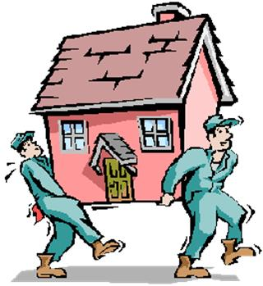
Case study timeline
Removed from Parents Emergency Foster Care
2 Weeks later the children then moved to a short term placement while care proceedings were conducted at court
4 months later The children were moved to another short term placement
14 months after entry into care - Care Order was granted and the care plan is to move the children into a permanent foster placement when a family is identified for all three children or adoption for Amy potentially with Jordan while Tia would move into long term care.

Slide 7
Exercise - Small Group discussion counsellors initial thoughts
Talk with the people in your vicinity........Bearing in mind potential trauma triggers ......
Based on minimal information ….What are your first impressions as a counsellor being presented with these three children for therapy?
What is already influencing your thinking ?
Notes:
Exercise 1
5 minutes – quick discussion with neighbours
5-10 minutes feedback points on flipchart

Slide 8
Therapy Referral information (1)
A referral arrives at your agency or private practice for the three children.
The referrer states that the children are in care of the local authority
Despite a disclosure at school Tia initially refused to talk to the social worker and said she was happy at home.
Tia did eventually admit there was domestic violence within the home between her parents.

Slide 9
Therapy referral information (2)
Foster Carer and social worker are concerned that the children need therapy as ;
Tia and Jordan both have prolonged tantrums.
Tia is described as fiercely independent and often angry with adults. Tia is described by social worker and carers as resistant to the care of the foster carers. For example she took Amy away when the carer tried to change the baby. She is now having periods of suddenly shouting and screaming at school and placement. Tia has stated that she wants to go home.
More recently in her present placement she has told her carer that it was she who looked after the two younger ones when her parents went out drinking or if they had been sleeping after lots of drinking and having friends around the house. She liked to go to school as she had friends there and got breakfast and dinner but if mum and dad were asleep she used to stay home to look after with Amy and Jordan.

Slide 10
Therapy referral information (3)
Jordan is described as following the carer around the house and needs constant attention. He fights other children at school. The carer is worn out emotionally and physically by his behaviour
Amy is said to express little emotion towards her carers despite being in the foster placement for the past 10 months. She is now walking and says a few words but never initiates any tactile behaviour with her carers. However she will hug and kiss Tia and Jordan and laugh with them. The carers both feel rejected by the toddler.
Social worker and carer have requested therapy for all three children to assess how the children are managing the trauma they have experienced. The ultimate plan is to prepare the children for a new long term family in the near future.

Slide 11
The Child’s Perspective on referral
The Child’s Story………
Notes:
Read the story of Jordan and his perspective here…. (Copies for delegates?)

Slide 12
How the trauma Brain works…Video
You Tube Van Der Kolk 24 Oct 2014 clip 2 minutes 50 secs
Three Ways Trauma can change the brainV20an 019
Notes:
Play You Tube clip Bessel Van Der Kolk “Three Ways Trauma can change the brain”

Slide 13
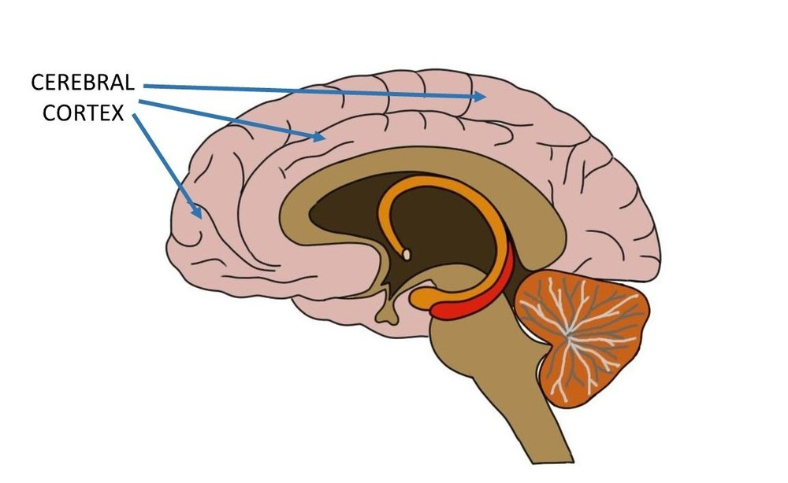
BRAIN BASED TRAUMA
Emotional Centre
This part of the brain forms earliest and depends on carers to co regulate
Cortex
the logical, thinking enabling part of the brain helps us to manage our feelings and forms fully around 3 years of age
Notes:
MENTION WHAT HUGHES & JON BAYLIN WOULD SAY REGARDING CHILD’S BRAIN ACTIVITY AND TRAUMA.
When amygdala functioning is in charge of brain activity cortex goes off line and needs to be brought back online...(co regulation of carers role)
Therefore children are dependent upon adults for co regulation until their cortex fully forms and allows some self regulation. If the carer is not functioning due to their own experience of trauma and attachment needs the baby also looses the opportunity for co regulation, developing trust and dependence upon others which in turn impacts upon sense of the self and sense of other.

Slide 14
TIA Hypothesizing The Trauma
In terms of a trauma experience and brain impact let’s look at what might be happening for each child physically and emotionally……….
Tia has experienced physical harm during DV incidents, coupled with the emotional impact of witnessing mum hurt and feeling powerless to intervene successfully and stop Dad. What can we hypotheses about her brain activity during the DV incidents and any legacy upon her in the here and now?
Attachment - Shield of shame ...mistrust high.... Insecure attachment style (avoidant ?) more likely to develop as a response to inconsistent care giving from main carers.
Brain on high alert due to DV incidents within the home, therefore hypervigilant to danger and sensory responses heightened – amygdala functions in “on” position more regularly than other children of the same age due to a need to protect self and others therefore heightened awareness of potential danger to mum, siblings and possibly other people such as peers.
Notes:
Discuss each point and encourage audience participation

Slide 15
Jordan
Jordan- heightened fear response to Dad, witnessing his father harm his older sister recognising that his dad is also one of his main carers therefore what would attachment theory tell us abut this relationship and trauma response impact?
Attachment – insecure style would be dominant and there are indicators of fear in his clingy behaviour towards his carer. He has to ensure his carer is in his sight and that he is in her sight. Fear leads to an increased sense of the need to control. (Dan Hughes –2012)
Attachment between siblings – positive indicators for the sibling group, strongest relationship likely to be with his two siblings
Brain – amygdala functioning on high alert……the need for calming amygdala and bringing cortex online.

Slide 16
AMY
Amy- just learning to speak (pre verbal) when removed from parents but seeing and hearing sounds of fear and terror around her (possibly also while in the womb). Amy has also been placed in physical danger, there are signs of neglectful parenting and lack of stimulation, emotionally unavailable parents due to substance misuse – therefore what about her likely attachment style?
Attachment- she had consistent care from siblings therefore a more secure attachment relationship, inconsistent responses from main carers therefore an insecure style attachment towards parent figures, coupled with ages and stages of development expected would be co- regulating with carers, stimulation, physical growth, learning who are your family and discriminating between strangers type of behaviour towards people unknown
Brain – amygdala formed, cortex not formed fully until aged around 3 years….speech development, lack of stimulation, becoming stuck emotionally….early sense of self and others…..

Slide 17
Care system as part of the therapy
Therapist starting point is ........
The fact a child is in care means a therapist has to negotiate a specific legal system which differs to family court proceedings or divorce and parental separation.
Care system can either support or impinge upon a child’s resilience and subsequent therapy, depending partly upon professionals involved and circumstances.
Notes:
Bear in mind as a therapist -Difference with CIC is that usually when we work with bereavement, divorce, DV in the community the child has at least on secure attachment figure to support their therapy (indeed many parents refer the child). CIC often don’t live with a secure attachment figure from their birth family, they are on an finished journey in care, care proceedings may be ongoing.....care plan not agreed and potential moves ahead..”.placement” not” home”
However the idea of resilience is very important for this group of children.... And carers and therapist can be a positive part of the child building upon an innate sense of resilience.

Slide 18
Care system
Child
Carer
System
Professional
Self

Slide 19
Transition during therapy
Planned Moves -Therapists working with children in care need to be aware that the child e.g. Tia and Jordan and Amy may be in transition soon after work commences. In our case study we know that the present placement is short term (10 months to date and the children will move on as part of permanency planning)
Disruptions - However for some children the move is a consequence of other factors such as disruption and carers giving unexpected notice of 28 days leading to a hurried search for new carers. Therefore in such circumstances the security of basic human needs (Maslow 1943) i.e. a permanent home is non existent
Notes:
Explain Maslow and also transition and the need for clear staged therapy goals set with young person first and professionals also.
Types of reasons for a disruption? Holiday period and escalation of behaviour du to lack of structure and routine of school and other activities. Children demanding different things from the carer and carer feeling overwhelmed and unable to meet the needs presented of some or all the children within the group, children abusing each other physically (give e.g. from casework and together or apart decisions). How dos this decision making play into the trauma and attachment needs and consequent presentation off the child? What should we do as therapists to counteract this? Preparation, good communication with other professionals is the plan but not always adhered to....

Slide 20
Context of the therapy
Child may be separated from siblings into a new placement due to the demanding competing needs of the children, the availability of skilled and experienced carers etc....
The Counsellor becomes part of the system – in terms of attending care reviews, encountering the impact of contact with birth family upon the children and negotiating and holding clear confidentiality boundaries versus expectations of the social worker/system in terms of information sharing
Notes:
Reality that the therapist is working within a complex system and children have unplanned transitions which disrupt and interrupt the therapy. Change of carers means a lack of containment in some cases and carer needing to “buy in” to working with therapist to provide some sense of security and a more secure attachment figure during the therapy. Therapist may also become the only professional who is available throughout the care journey and therefore becomes part of the child’s attachment figure group.

Slide 21
Working to promote resilience
Connectedness
Regulation
Integration
Leads to resilience

Slide 22
Resilience – open group Discussion Points
What is it?
How do we approach assessing a child’s resilience?
Notes:
Quick points and definitions – 5 minute place points on flip chart (scribe?)

Slide 23
The Resilience Matrix
Resilience Factors
Adversity
factors
Protective factors
Vulnerability Factors
Wassell & Daniel (2002)
Notes:
Introduce the matrix as ONE simple approach to mapping where a child is when therapy commences. It is not an exact science it is open to individuality but provides therapist with a starting point to hang thoughts and observations upon and track what seems to contribute to the child’ s sense of self (e.g. talents and interests), sibling relationships which arrive into the care situation due to family scripts.
3 groups to look at each child and how they might map them onto the matrix (depend on numbers in workshop decide group composition).

Slide 24
Resilience Matrix
Resilience Factors e.g. likeable personality, good friendships, has at least one trusted adult in their life
Adversity
Factors
Separation and loss of birth parents, being in care
Protective factors secure placement carers committed long term, placed with siblings
Vulnerability Factors – family script, position within family e.g. the scapegoat...
Wassell & Daniel 2002
Notes:
One of the ways we can hypothesise is the resilience matrix

Slide 25
EXERCISE
HOLDING IN MIND THE RESILIENCE MATRIX
THREE GROUPS -WHAT FACTORS CAN YOU IDENTIFY FOR EACH CHILD TIA, JORDAN AND AMY?
USING A TOOLBOX HOW MIGHT YOU WORK WITH YOUR CHILD?
Notes:
10-15 minutes max (Depending on time – demonstrate on flip chart paper as part of their feedback or Hold back the toolbox exercise until later)

Slide 26
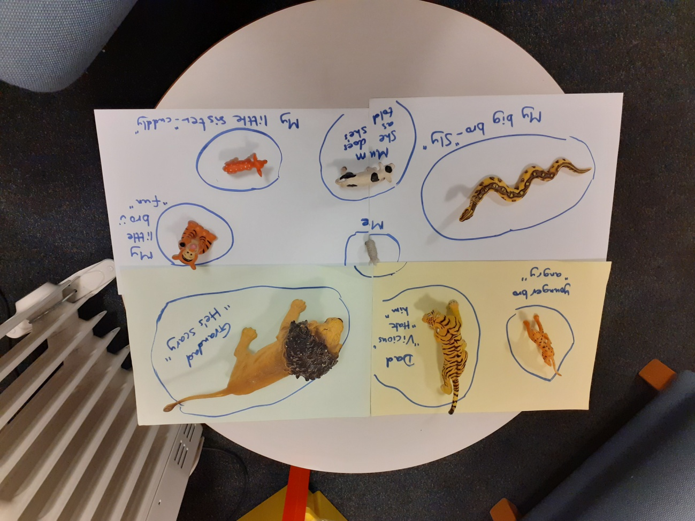
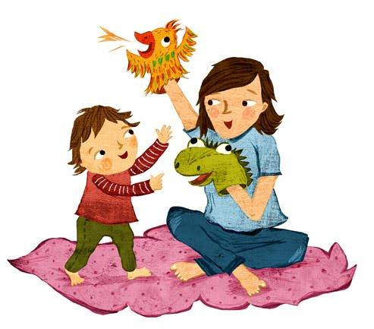
Connecting with children and building on resilience
Notes:
PERSON CENTRED THERAPIST BELIEF - CHILDREN HAVE VARYING DEGREES OF RESILIENCE AND THERAPISTS BUILD UPON THIS AS OPPOSED TO CREATING RESILIENCE (OTHERS MAY HAVE ANOTHER VIEWPOINT HERE TO NOTE).

Slide 27
Creative counselling sessions

Slide 28
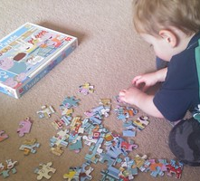
Therapists role in terms of resilience- what is it?
“Helping the client feel safe enough to know what they know and feel what they feel” Van Der Kolk (2017)
“We need to feel safe enough to expand, explore, grow, learn, transform” Foscha (2016)

Slide 29
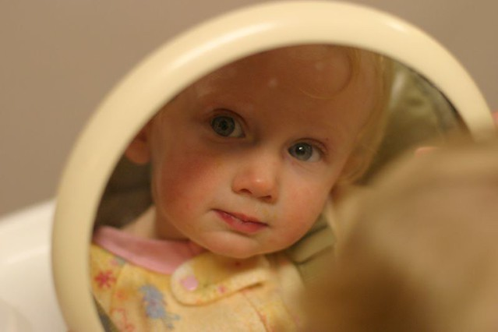
Resources FOR WORKING WITH CHILDREN
MIRROR WORK (SELF ESTEEM)
SELF DRAWINGS, MASKS, MAKING ITEMS ALONGSIDE CHILDREN (DEVELOPING SENSE OF SELF WORK)
MUSIC – USE OF APPS, DANCE WITH OLDER CHILDREN,PEEK A BOO, A SAILOR WENT TO SEE...
STORY TELLING AND WRITING- Golding (2014)
Notes:
2 CHILDREN WHO USED DANCE FROM STAGE SCHOOL OR SCHOOL PLAYS WITHIN SESSIONS.
STORY WITH 8 YEAR OLD AND 11 YEAR OLD (SELF WRITTEN AND CO WRITTEN)
Storytelling is helpful - we need to use narrative to fill in gaps in the jigsaw as far as possible
DRAWING ALONGSIDE ON YOU TUBE – BUILD RELATIONSHIP AND ENCOURAGE A SKILL WHICH PROMOTED HIS SELF ESTEEM.

Slide 30
RESOURCES FOR WORK WITH CARERS AND CHILD/CARER ALONE
DYADIC DEVELOPMENTAL PSYCHOTHERAPY(DDP -DAN HUGHES)
FILIAL THERAPY
THERAPLAY
NURTURING ATTACHMENTS/FOUNDATIONS for ATTACHMENT *
FAMILY THERAPY
VIDEO
INTERACTIVE
GUIDANCE
Notes:
PUT INFO RE KIM GOLDINGS WORK HERE
AIMS OF THE PROGRAMME AND CASE STUDIES FROM OWN PRACTICE OF WHAT HAS WORKED WELL AND BEEN SUPPORTIVE OF THE CHILDREN
Resources List for working with Carers
Dens
Blankets
Cushions
Soft toys

Slide 31
QUESTIONS?
ANY QUESTIONS

Slide 32
REFERENCE LIST
Foscha, D. (2016) An Interview with Diana Foscha on Accelerated Experienced Dynamic Psychotherapy (AEDP) , accessed www.psyhcotherapy.net
Golding, K.S,(2014) Using Stories to Build Bridges with Traumatized Children: Creative Ideas for Therapy, Life Story Work and Parenting, Jessica Kingsley, London.
Golding, K.S., (2013) Nurturing Attachments: Supporting Children who are Fostered or Adopted, Jessica Kingsley, London.
Herman, J.L., (2002) Recovery from psychological trauma. Psychological Clinical Neurosciences Vol 52, Issue (S1) accessed http://onlinelibrarywiley.com
Hughes, D.A., (2017) (3rd ed.) Building The Bonds of Attachment: Awakening Love in Deeply Traumatized Children, Jason Aronson, New Jersey.
Hughes, D.A., & Baylin, J , (2012) Brain Based Parenting: The Neuroscience of Caregiving for Healthy Attachment, WW Morton & Company
Maslow, A.H., (1943) A Theory of Human Motivation Psychological Review. 50(4):370-96
Van Der Kolk, B., Three Ways Trauma Can Change The Brain accessed on You Tube 24th October 2014.
Van Der Kolk, B, (2014) The Body Keeps The Score: Brain, Mind & Body in the Healing of Trauma, Viking
WASSELL, B., & DANIELS,S (2002)The early years:assessing and promoting resilience in vulnerable children (1) , Jessica Kingsley, London.

Slide 33
Recommended reading
Cairns,K., & Cairns, B., (2002) Attachment, Trauma and Resilience, London; BAAF
Sutherland, M., (2000) Helping Children who Bottle up Their Feelings, Speechmark: Oxon
Sutherland, M., (2003) Helping Children with Low Self-Esteem, Speechmark: Oxon
www.childrenscommissioner.gov.uk
www.ddpnetwork.org.uk

Slide 34
Contact Details
Joy Stewart based at MYRESET Counselling (Private Practice)
And at Beyond The Horizon Charity working with children who have experienced loss, bereavement, parental separation and the impact of domestic violence.
Email joybelle55@sky.com
j.stewart@beyondthehorizon.org.uk
Contact Number – 07950247330/0121 444 5454

