Slide 1
You can’t make someone have resilience and self esteem: It’s already there just waiting to come out. BACP Children Young People and Families Conference Resilience: helping children and families develop an emotional shield London 22 February 2020

Slide 2
.

Slide 3
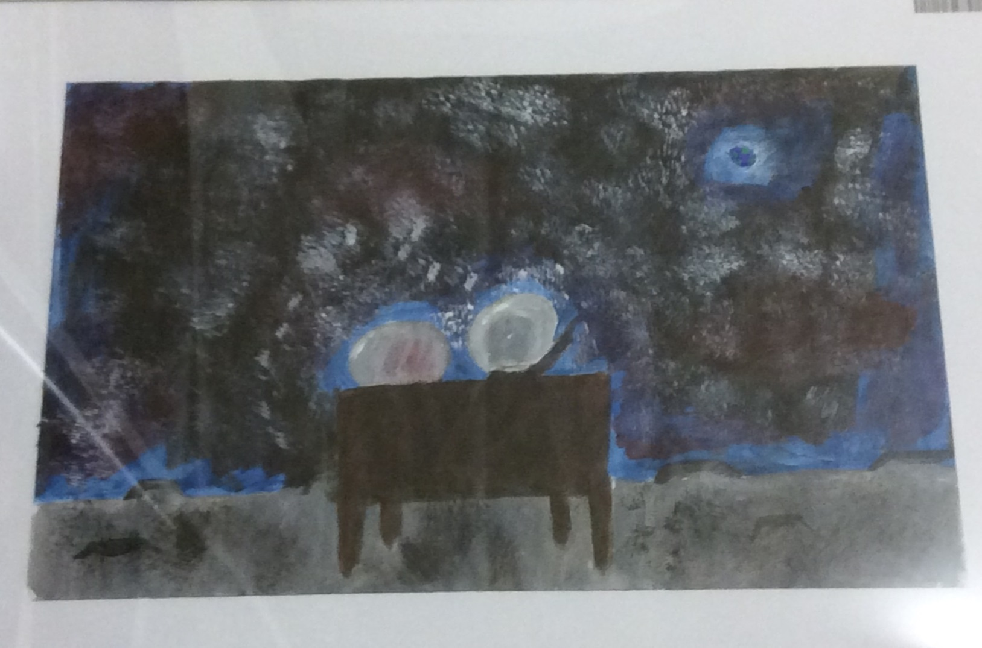

Slide 4
Discovering Resilience

Slide 5
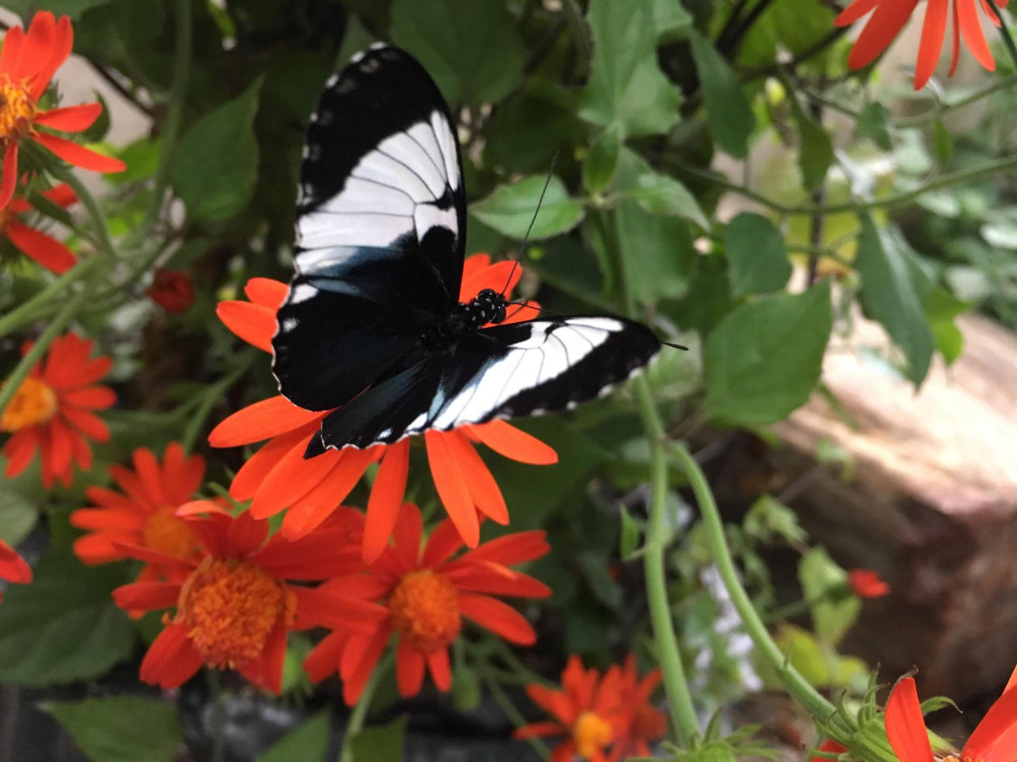
Discovering self-esteem
Notes:
Terms we may use

Slide 6
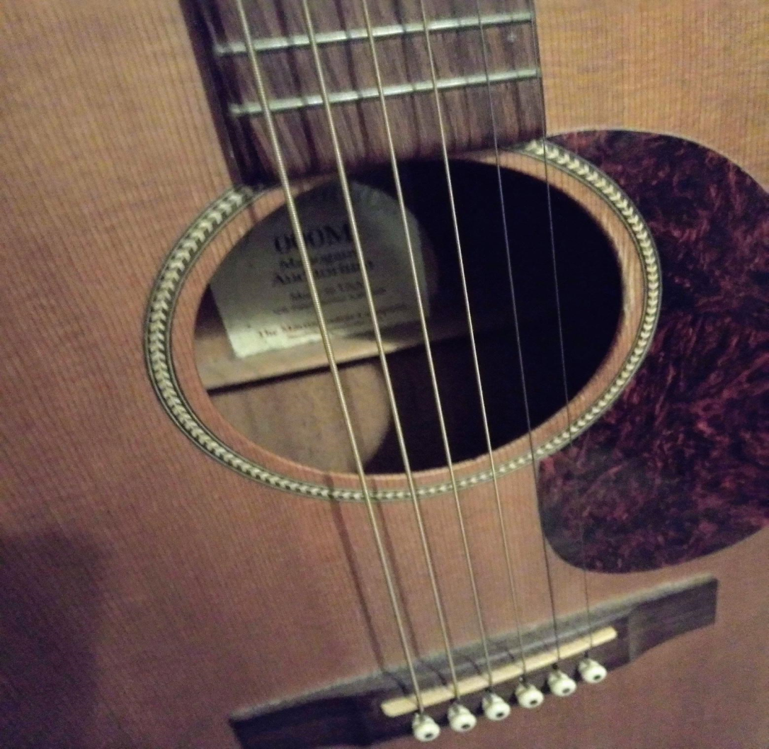
Resilience and self-esteem connect

Slide 7
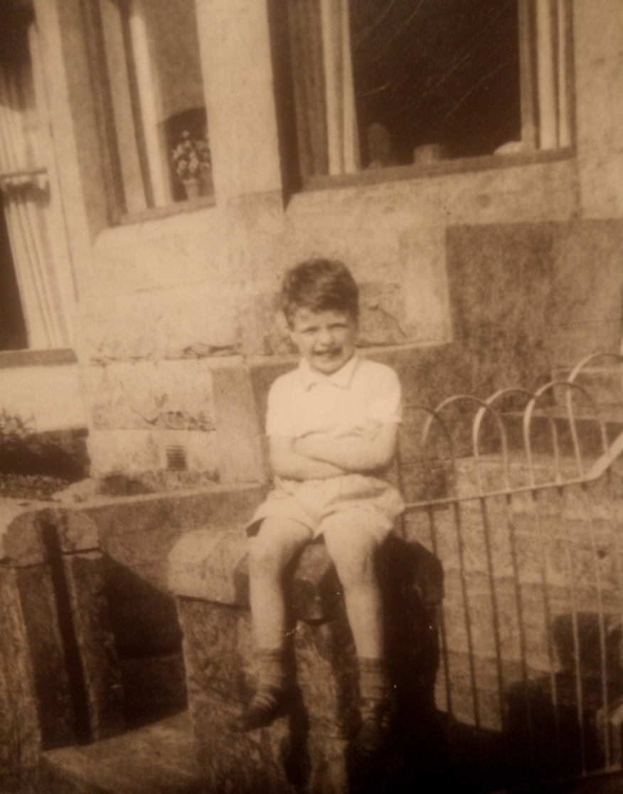
You can only be you

Slide 8
Stored up energy

Slide 9
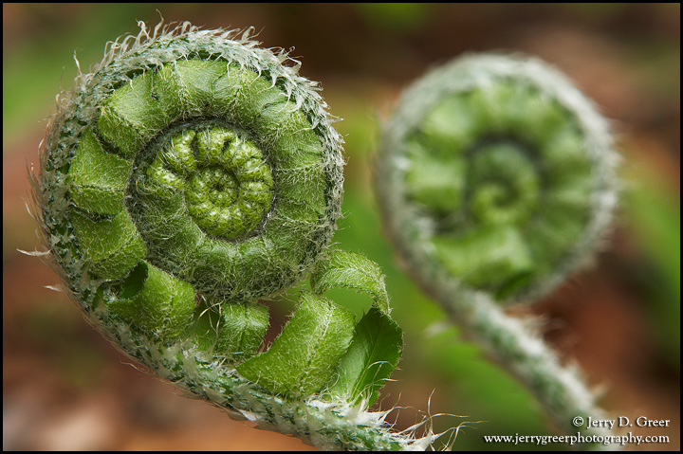
Experiencing your own wisdom
Imagination
Exploration
Insight
Felt sense
Caring
Belonging
Connecting

Slide 10
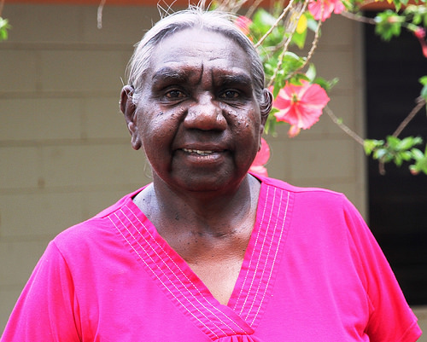
Dadirri: in our belongingness
… inner, deep listening and quiet, still awareness. It recognises the deep spring that is inside us. We call on it and it calls to us. This is the gift we are thirsting for. It is the awareness of where you've come from, why you are here, where are you going now and where you belong.
Miriam –Rose Ungunnmerr Source: Deep listening (dadirri) - Creative Spirits, retrieved from https://www.creativespirits.info/aboriginalculture/education/deep-listening-dadirri

Slide 11
Listening for resilience
There is no urgency to do, unless the urgency is created in me
Can I take the time that the healing needs
Can I trust the direction towards healing will be made known
Is the relationship already there to help wisdom emerge
Can I connect to the other at a level of depth
Do I trust this encounter as significant

Slide 12
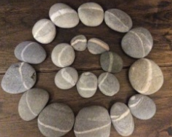
mike moss counselling supervision & training
mike.moss@outlook.com

